Slide 1
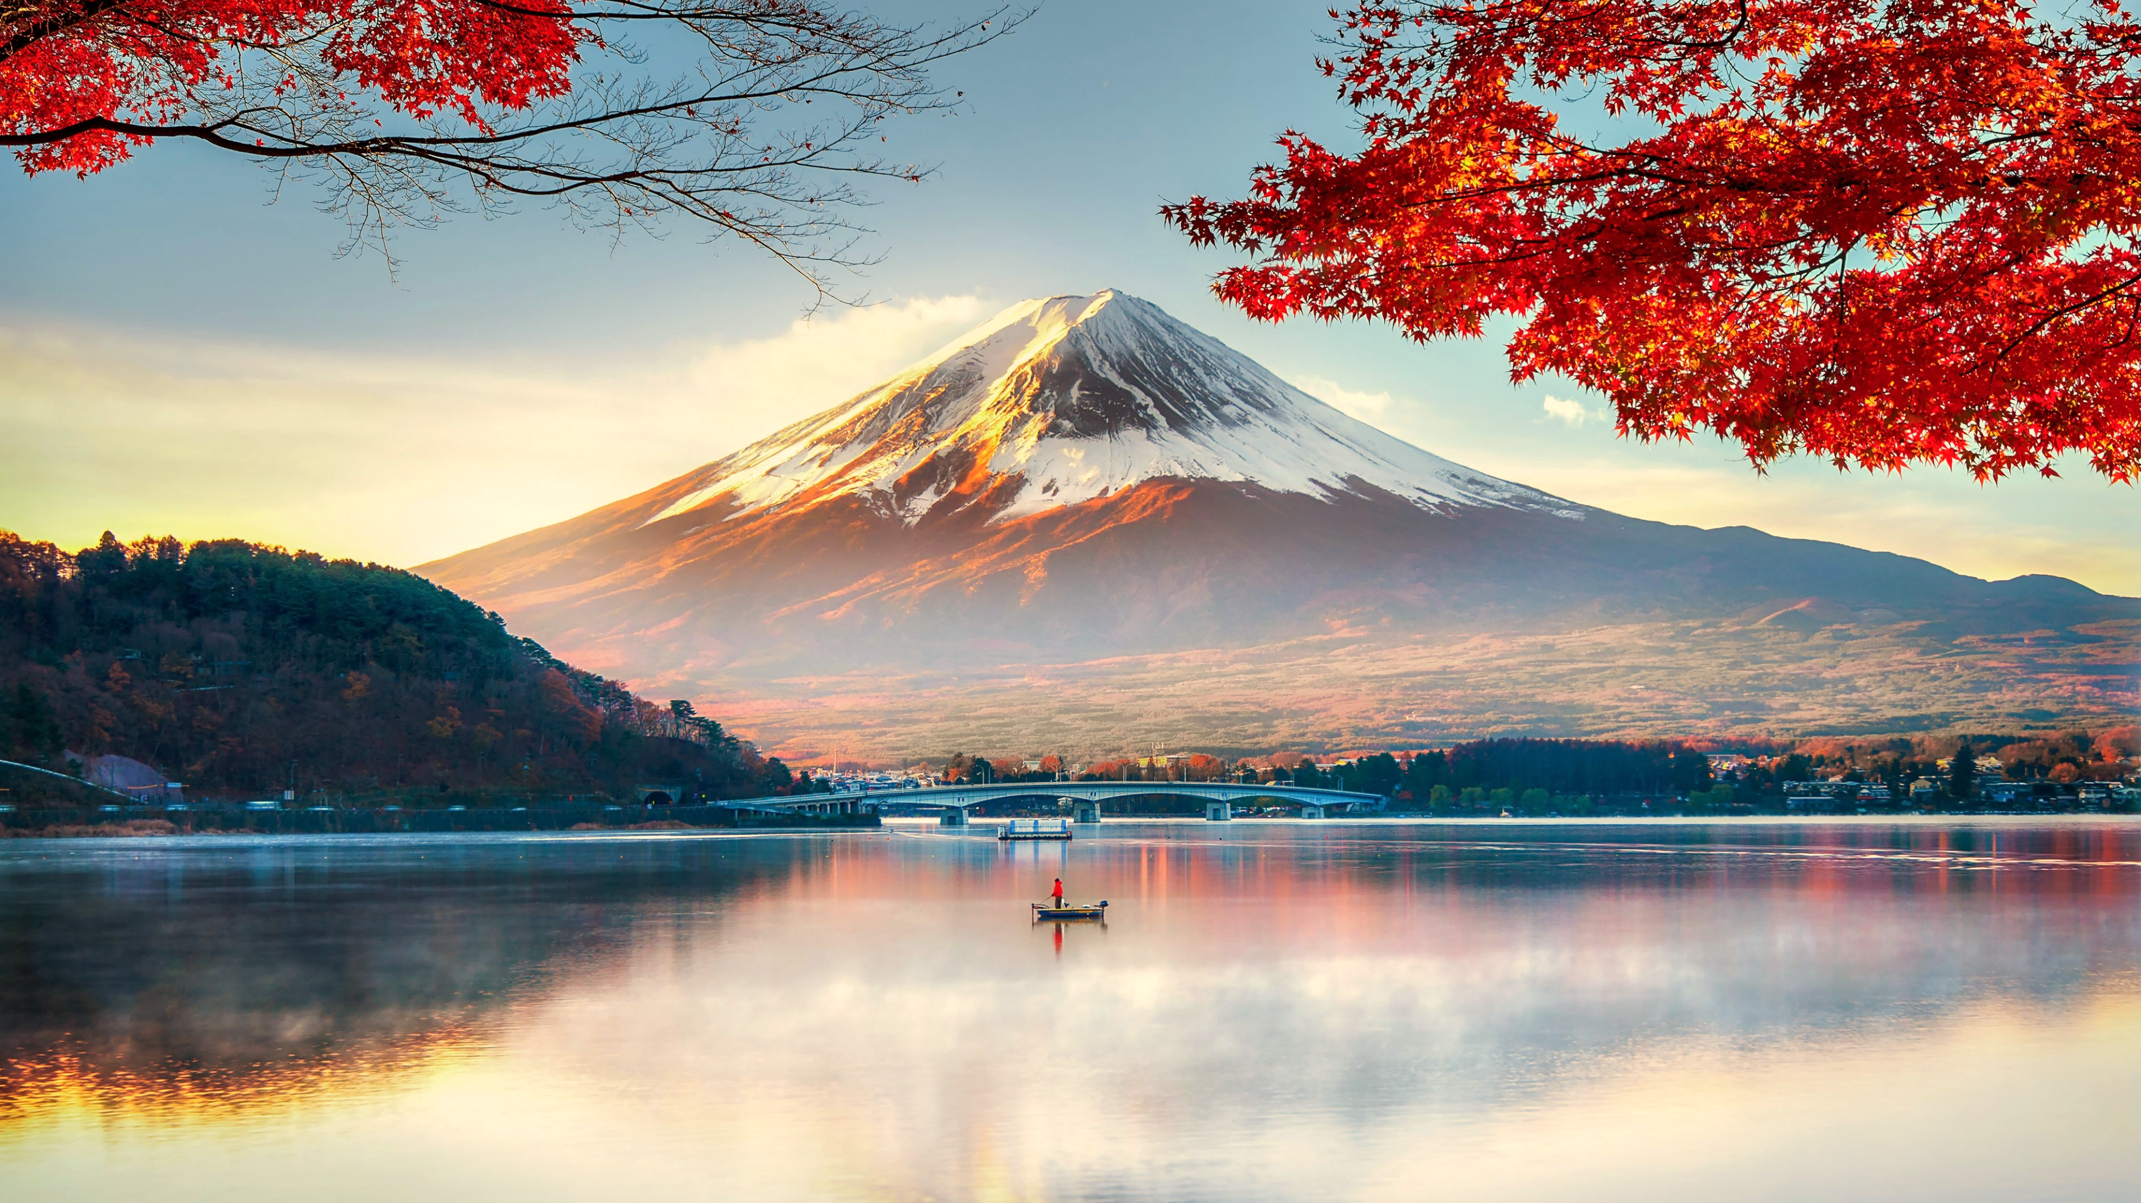
Foreign Excursion Tour ‘24

Slide 2
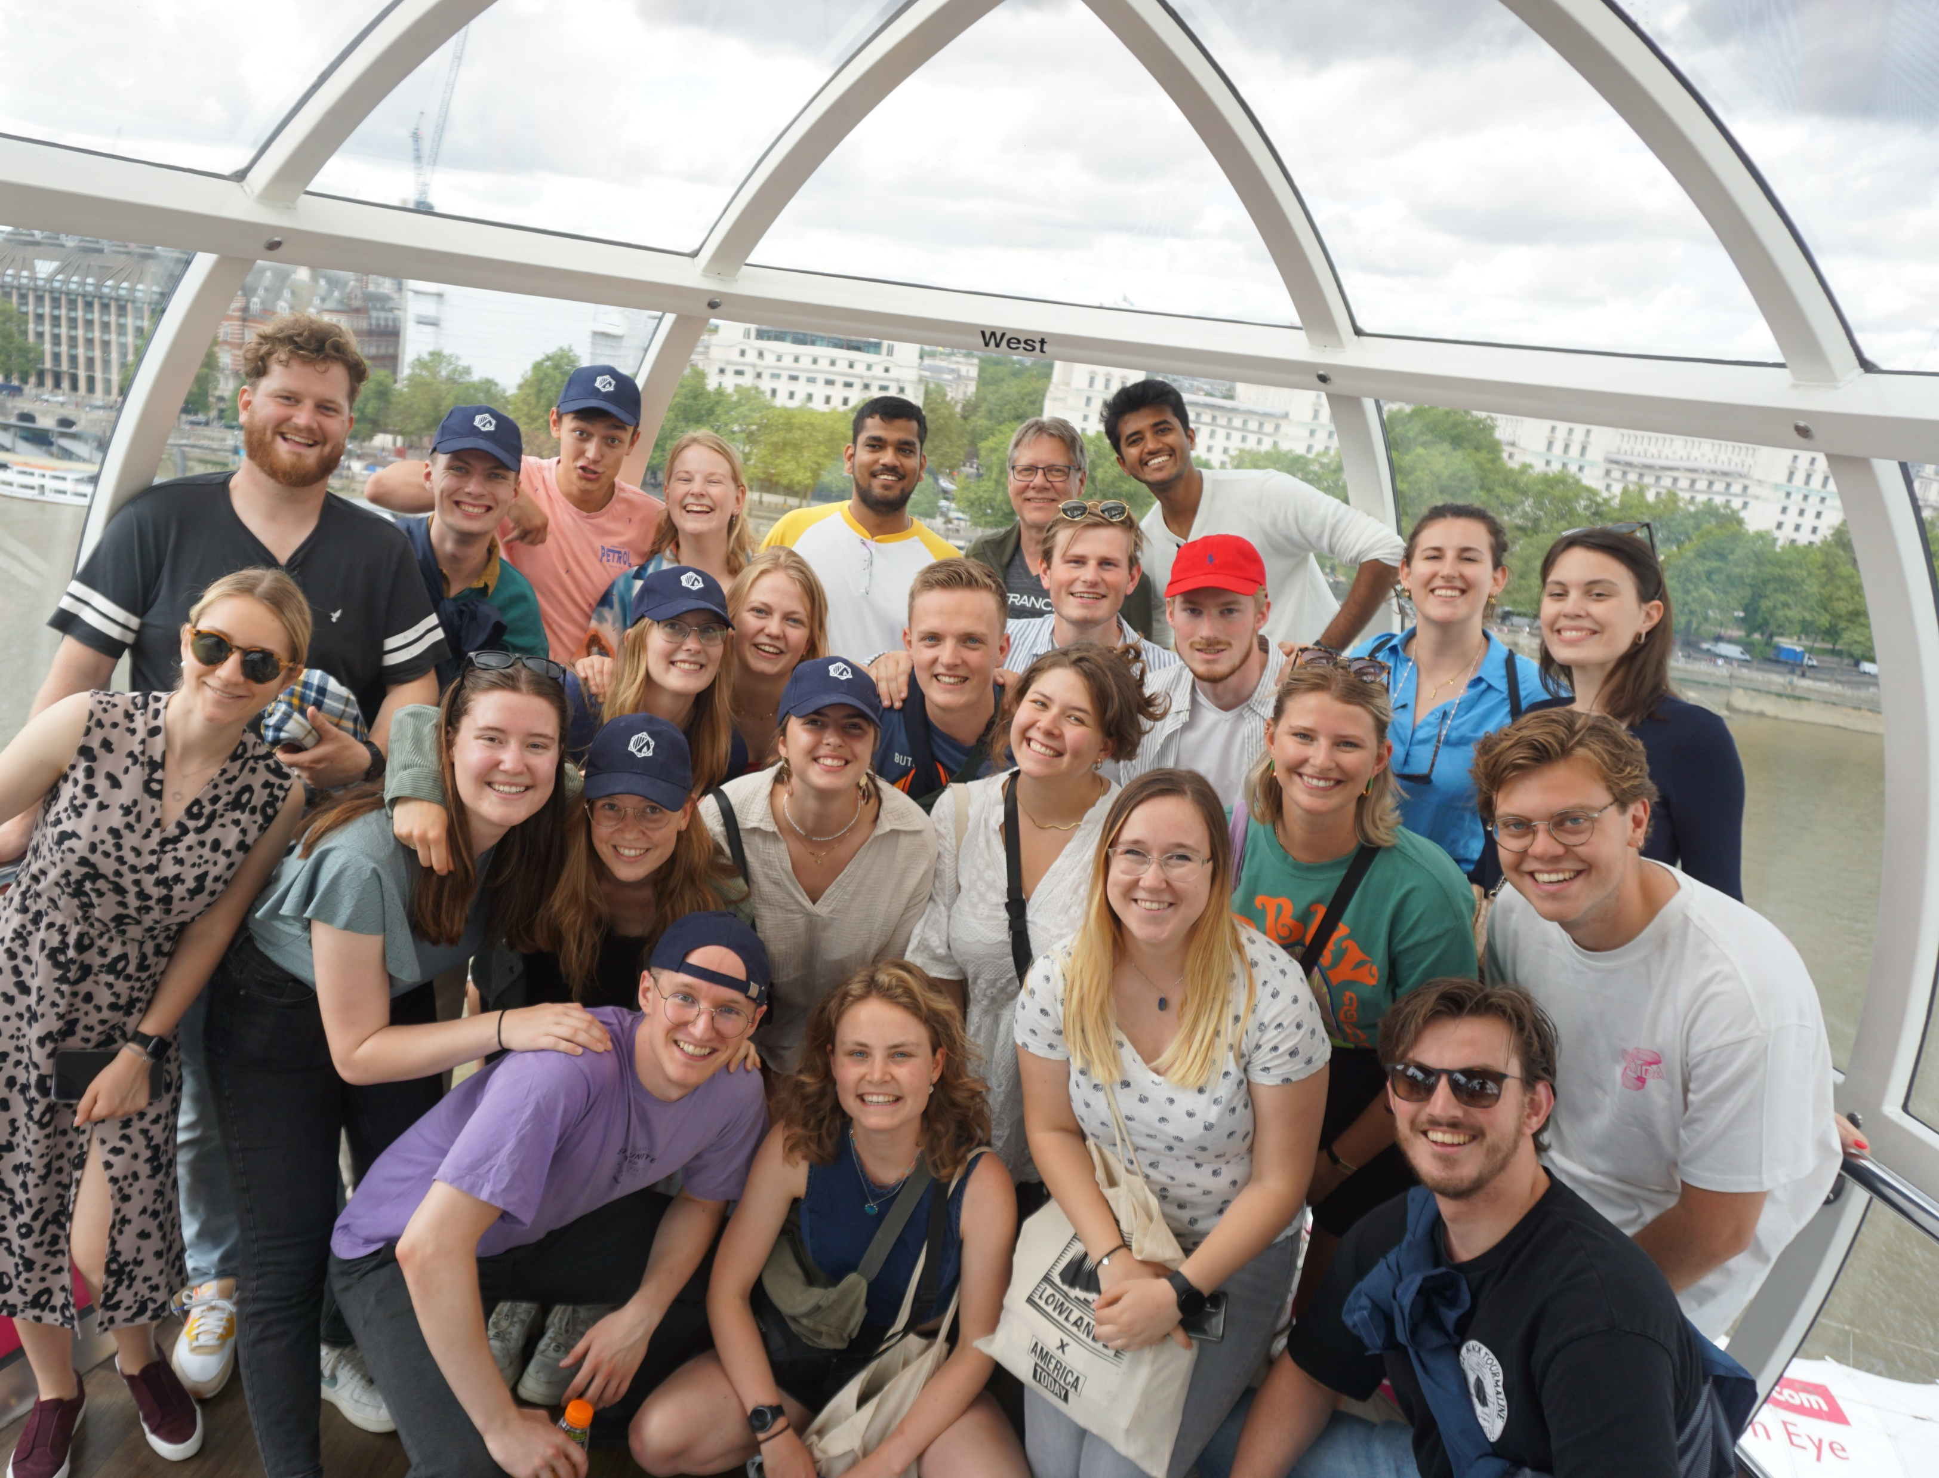
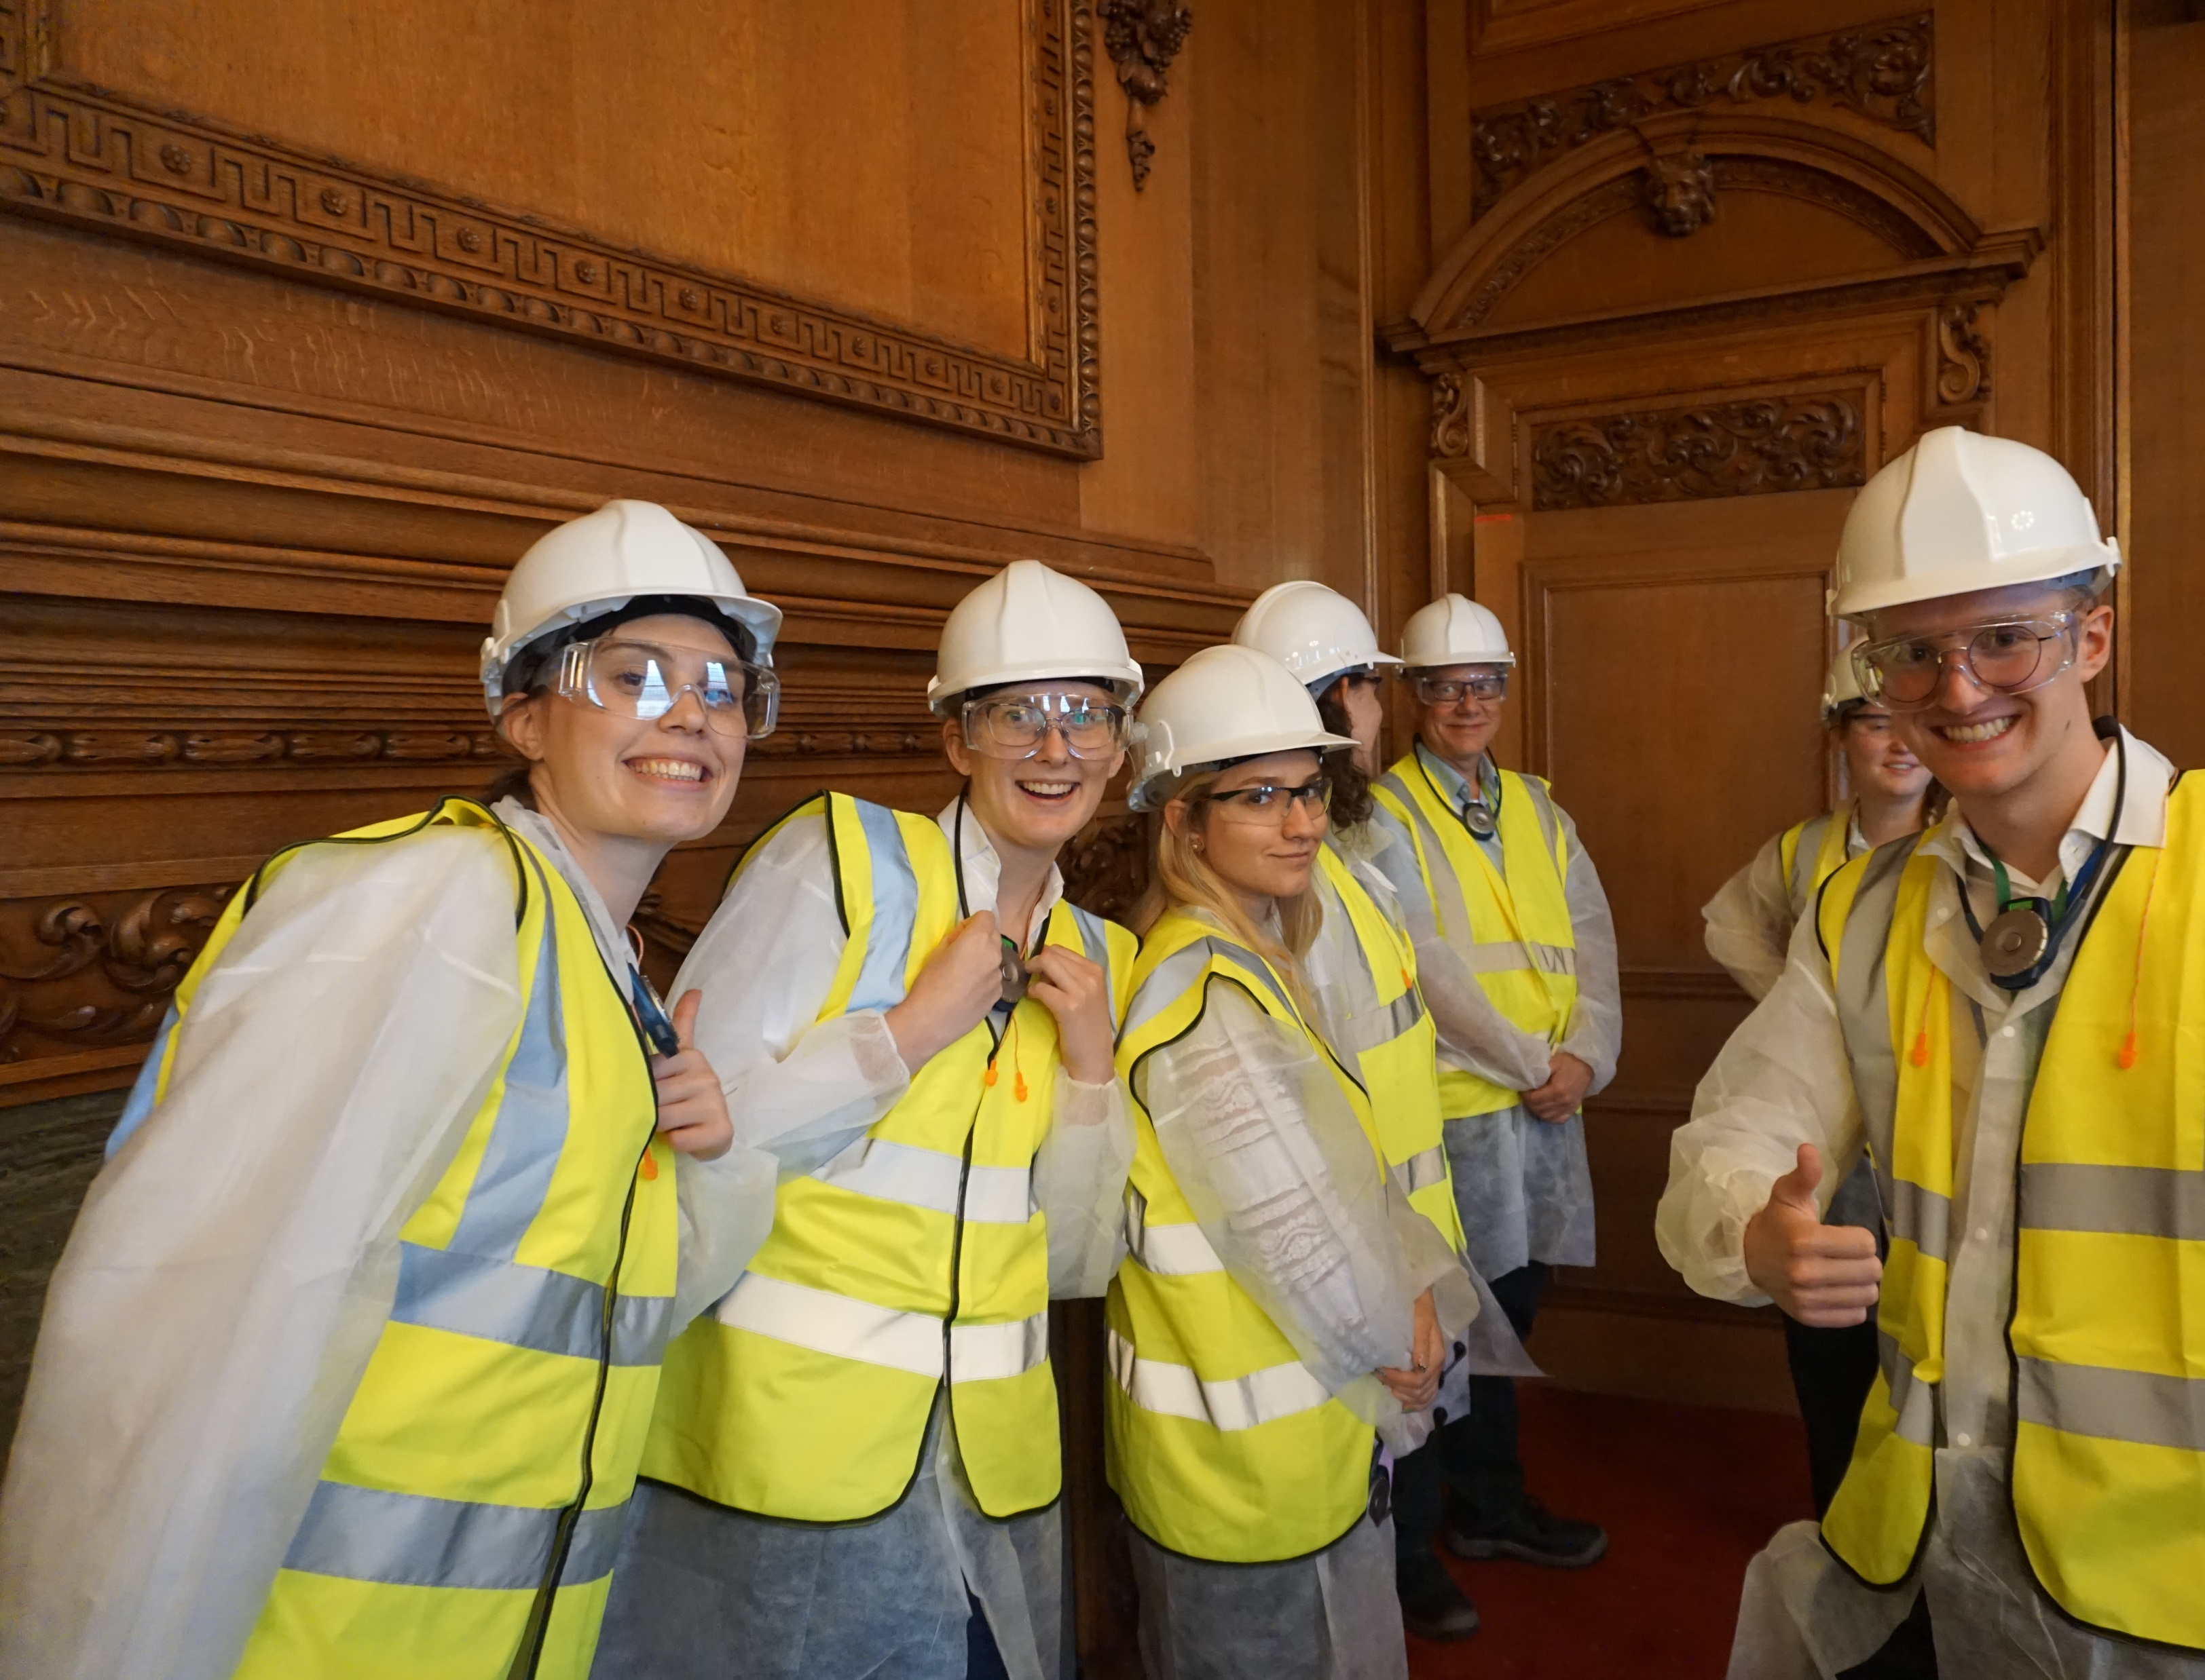
FET:
3 week trip outside of Europe!
2 week case study for a chemical technological company
Company & university visits
Cultural & fun activities
Free time
Networking, fun, adventure

Slide 3
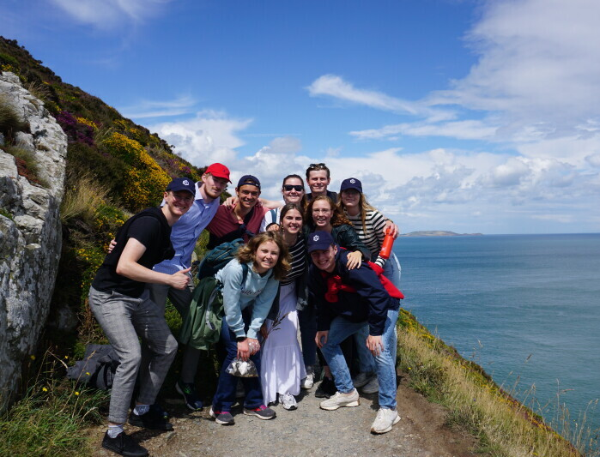
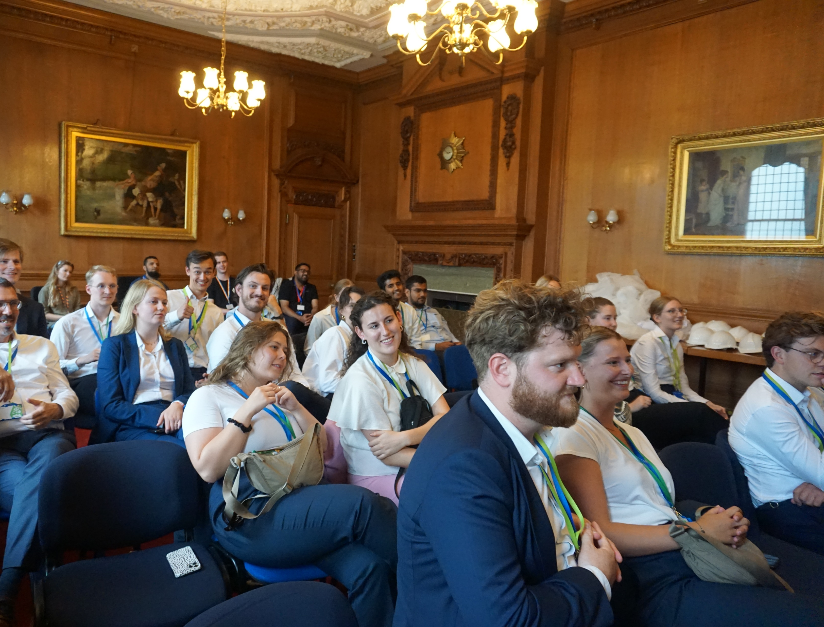
Dates:
Trip: 15th of July – 6th of August
Case study: 1-12th of July
Case evenings: 15th of May & 4th of June
Company dinner & lunch lecture

Slide 4
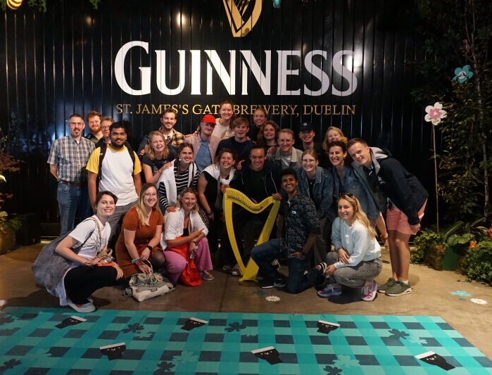
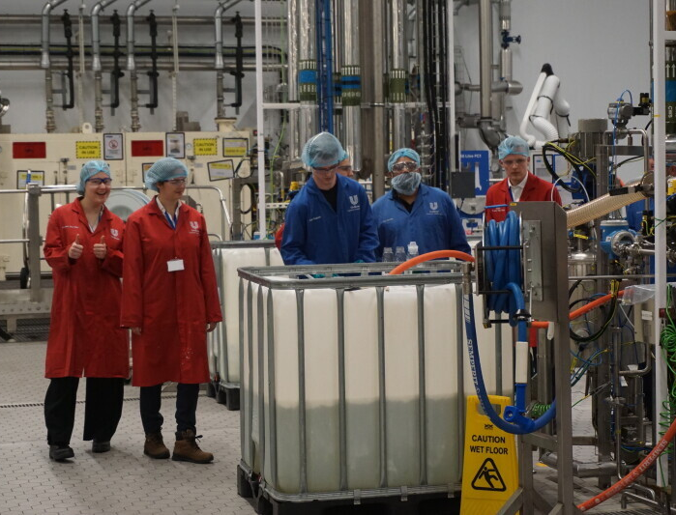
Next steps:
Sign up!
Motivation letter
(Draw)
Contract

Slide 5
Draw:
Groups:
Candidate-participant meets all criteria.
Candidate-participant meets criteria 1 & 2 and is an old member of the FET committee.
Candidate-participant meets criteria 1 & 2 only.
Candidate-participant meets criteria 1 & 3, but not 2.
Candidate-participant meets criteria 2 & 3, but not 1.
Candidate-participant does not meet criteria 1 & 2.
Criteria:
Candidate-participant has obtained a minimum of 93 ECTs on September 1st. (Bachelors only)
Candidate-participant has completed all first-year courses on September 1st. (Bachelors only)
Candidate-participant has not already participated in a previous Foreign Excursion Tour.

Slide 6
Contract:
Official participant
Payment information
Conditions

Slide 7
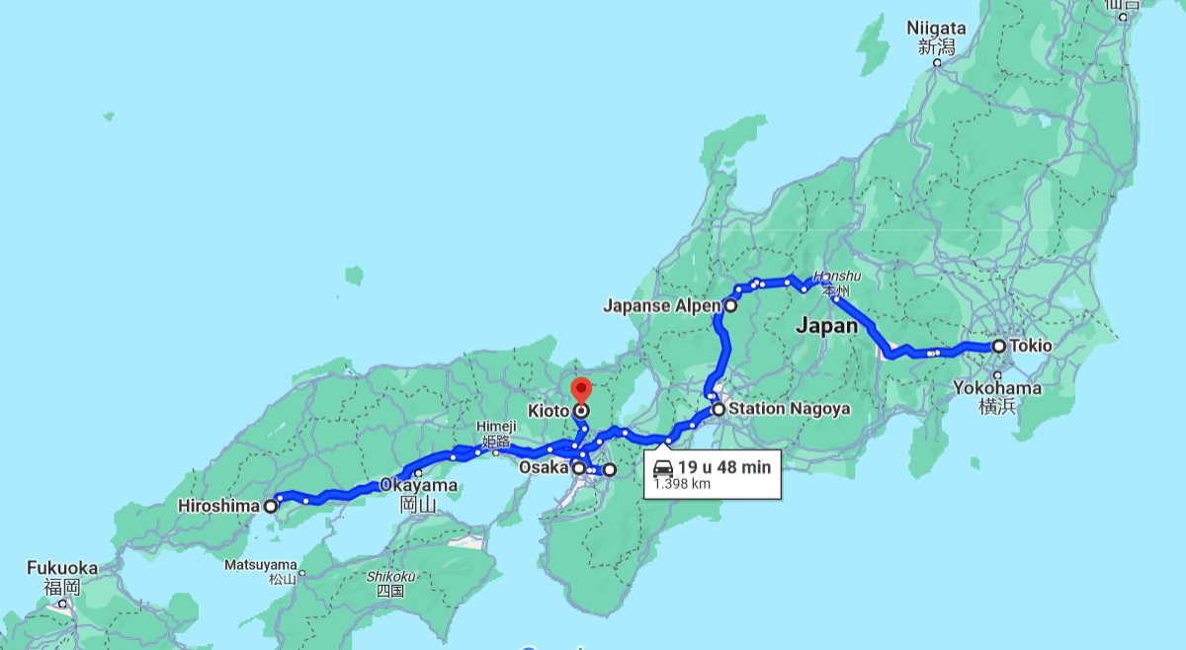
Global itinerary:
Day | City
1 | Tokyo
2 | Tokyo
3 | Tokyo
4 | Tokyo
5 | Toyko
6 | Toyko
7 | Japanese alps
8 | Japanese alps
9 | Nagoya
10 | Nagoya
11 | Osaka
12 | Osaka
13 | Osaka
14 | Nara
15 | Hiroshima
16 | Hiroshima
17 | Kyoto
18 | Kyoto
19 | Kyoto
20 | Osaka

